Slide 1
Comment on State Functions
P, T, and V are the state functions, Q and W are not. Specifying an initial and final state of a system does not fix the values of Q and W, we need to know the whole process (the intermediate states). Analogy: in classical mechanics, if a force is not conservative (e.g., friction), the initial and final positions do not determine the work, the entire path must be specified.
In math terms, Q and W are not exact differentials of some functions of macroparameters. To emphasize that W and Q are NOT the state functions, we will use sometimes the curled symbols δ (instead of d) for their increments (δQ and δW).

Slide 2
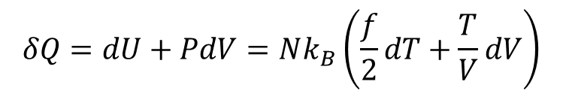

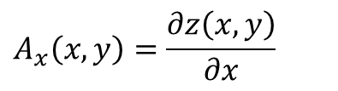


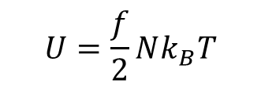

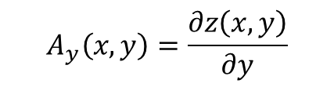
Comment on State Functions
Example
y
z(x₁,y₁)
It is an exact differential if it is the difference between the values of some (state) function z(x, y) at these points:
z(x₂,y₂)
x
A necessary and sufficient condition for this:
If this condition holds:
$$A_{x}\left(x,y\right)=\frac{∂z\left(x,y\right)}{∂x}$$
$$A_{y}\left(x,y\right)=\frac{∂z\left(x,y\right)}{∂y}$$
$$U=\frac{f}{2}Nk_{B}T$$
e.g., for an ideal gas:
$PV=Nk_{B}T$
And $dU=δQ−PdV$
$$dU=δQ+δW$$
$$δQ=dU−Pdv$$
$$δQ=dU+PdV=Nk_{B}\left(\frac{f}{2}dT+\frac{T}{V}dV\right)$$

Slide 3
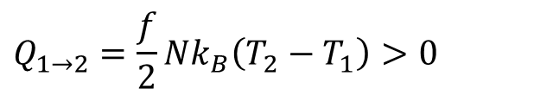

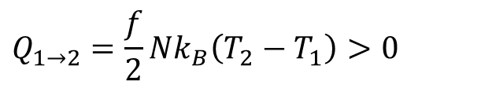

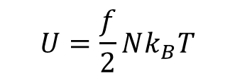
Quasi-static Processes in an Ideal Gas
Isochoric (V = constant)
P
2
$$W_{1→2}=0$$
$$dU=Q−PdV$$
PV= Nk_{B}T₂
$$U=\frac{f}{2}Nk_{B}T$$
1
PV= Nk_{B}T₁
$$Q_{1→2}=\frac{f}{2}Nk_{B}\left(T_{2}−T_{1}\right)>0$$
V_{1,2}
V
Isobaric (P = constant)
P
2
1
PV= Nk_{B}T₂
$$Q_{1→2}=\frac{f}{2}Nk_{B}\left(T_{2}−T_{1}\right)>0$$
PV= Nk_{B}T₁
V₁
V₂
V

Slide 4

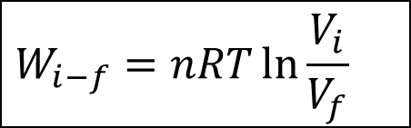
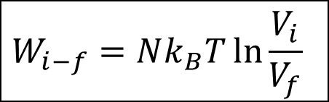
Isothermal Process in an Ideal Gas
Isothermal (T = constant)
P
PV= Nk_{B}T
$PV=Nk_{B}T$
W
V₂
V₁
V
$$W_{i−f}=Nk_{B}T\ln{\frac{V_{i}}{V_{f}}}$$
W_{i-f} > 0 if V_{i} > V_{f} (compression)
W_{i-f} < 0 if V_{i} < V_{f} (expansion)
OR
$$W_{i−f}=nRT\ln{\frac{V_{i}}{V_{f}}}$$

Slide 5

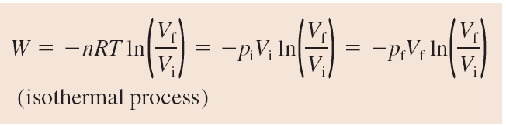

Work in Ideal-Gas Processes
In an isochoric process, when the volume does not change, no work is done.
In an isobaric process, when pressure is a constant and the volume changes by ΔV = V_{f} − V_{i}, the work done during the process is
$W=−P∆V$ (isobaric process)
In an isothermal process, when temperature is a constant, the work done during the process is

Slide 6
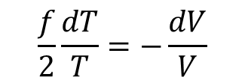
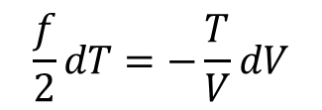
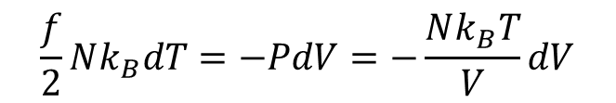

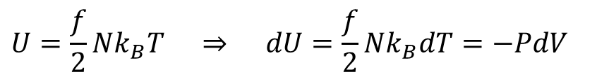
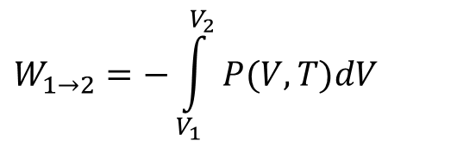
Adiabatic Process in an Ideal Gas
Adiabatic (thermally isolated system)
The amount of work needed to change the state of a thermally isolated system depends only on the initial and final states and not on the intermediate states.
$$W_{1→2}=−\int_{V_{1}}^{V_{2}}{P(V,T)dV}$$
P
2
PV= Nk_{B}T₂
to calculate W₁₋₂ , we need to know P (V,T)
for an adiabatic process
1
PV= Nk_{B}T₁
V₂
V₁
$$U=\frac{f}{2}Nk_{B}T ⇒ dU=\frac{f}{2}Nk_{B}dT=−PdV$$
V
( f – the # of “unfrozen” degrees of freedom )
$As dU=W=−PdV$ (for Adiabatic Process)
$$\frac{f}{2}Nk_{B}dT=−PdV=−\frac{Nk_{B}T}{V}dV$$
$$\frac{f}{2}dT=−\frac{T}{V}dV$$
$$\frac{f}{2}\frac{dT}{T}=−\frac{dV}{V}$$

Slide 7
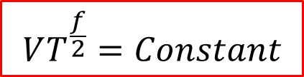

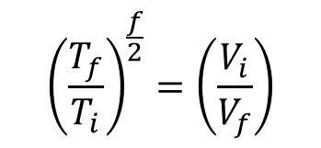
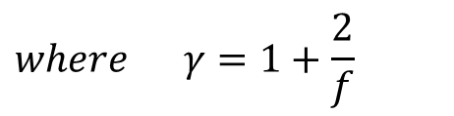
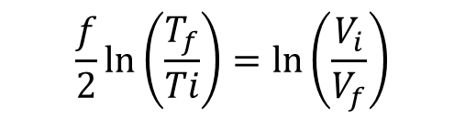
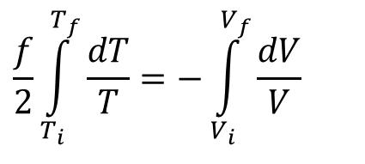

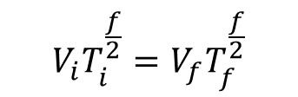
Adiabatic Process in an Ideal Gas (cont.)
Going from i → f $V_{i}→V_{f} and T_{i}→T_{f}$
$$\frac{f}{2}\int_{T_{i}}^{T_{f}}{\frac{dT}{T}}=−\int_{V_{i}}^{V_{f}}{\frac{dV}{V}}$$
$$\frac{f}{2}\ln\left(\frac{T_{f}}{Ti}\right)=ln\left(\frac{V_{i}}{V_{f}}\right)$$
$${\left(\frac{T_{f}}{T_{i}}\right)}^{\frac{f}{2}}=\left(\frac{V_{i}}{V_{f}}\right)$$
$$V_{i}T_{i}^{\frac{f}{2}}=V_{f}T_{f}^{\frac{f}{2}}$$
$$VT^{\frac{f}{2}}=Constant$$
One of your Assignment Problem
We can also write
$$PV^{γ}=const$$
$$where γ=1+\frac{2}{f}$$

Slide 8
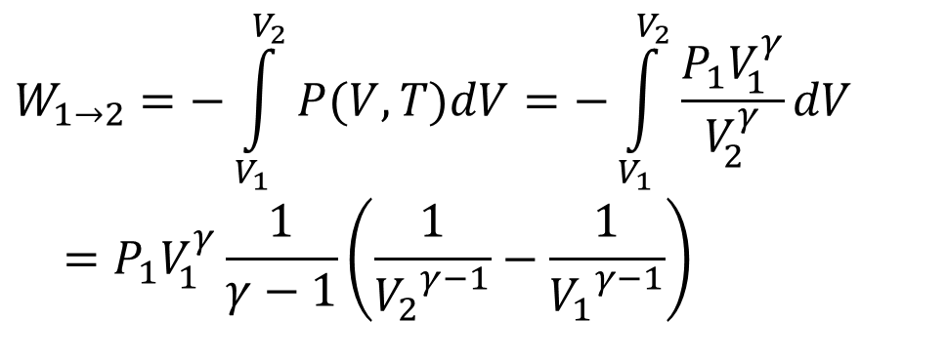
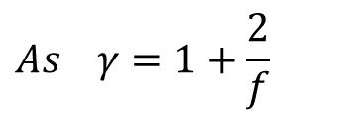

Adiabatic Process in an Ideal Gas (cont.)
$$P_{2}V_{2}^{γ}=P_{1}{V_{1}}^{γ}=const$$
P
2
An adiabat is “steeper” than an isotherm: in an adiabatic process, the heat flowing out of the gas comes at the expense of its thermal energy ⇒ its temperature will decrease.
PV= Nk_{B}T₂
1
PV= Nk_{B}T₁
V₂
V₁
V
$$W_{1→2}=−\int_{V_{1}}^{V_{2}}{P(V,T)dV}=−\int_{V_{1}}^{V_{2}}{\frac{P_{1}V_{1}^{γ}}{V_{2}^{γ}}dV} \\ =P_{1}V_{1}^{γ}\frac{1}{γ−1}\left(\frac{1}{{V_{2}}^{γ−1}}−\frac{1}{{V_{1}}^{γ−1}}\right)$$
$$As γ=1+\frac{2}{f}$$
  ⇒ 1 + (2/3) ≈ 1.67 (monatomic),
  1 + (2/5) ≈ 1.4 (diatomic), 1 + (2/6) ≈ 1.33 (polyatomic)
(again, neglecting the vibrational degrees of freedom)

Slide 9
Assignment#2 Due 2/4/2022
1.35, 1.39, 1.40 (only part a), and 1.41.
Problems for practice on Friday:
1.23, 1.24, 1.31, 1.32, 1.33, 1.34
Next: Isothermal and Adiabatic processes

